Slide 1

Unit-2 Flutter Architecture & UI Design
Mobile Application Development using Flutter (MADF)
DU # 2104CS501
Dr. Sharon V Mohtra
Department of Computer Applications
sharon.mohtra@darshan.ac.in

Slide 2

Outline
Flutter Architecture
Project Structure
Introduction to Widgets & types
Inbuilt Widgets
Stateless Widget
Stateful Widget
Material App, main()
Scaffold, Safearea
Text, TextFormField
Types of Button, SnackBar
Row, Column, Expanded
Stack, Image
Container, CardView
App Bar, Popup, Drawer
Looping

Slide 3
Flutter
Introduction

Slide 4
Flutter Introduction
Flutter is an open source framework developed by Google
It used for building beautiful, natively compiled, multi-platform applications from a single codebase.
It uses dart as a programming language for fast apps on any platform.
The first version of Flutter was known as Sky and ran on the Android operating system.
Flutter 1.0 was release on 11 December, 2019.
Flutter 3.3 was announced On August 30, 2022.
It Support two themes
Material Design widgets implement Google's design language of the same name.
Cupertino widgets implement Apple's iOS Human interface guidelines.
Flutter Supports IDES and Editors via plugin.
IntelliJ IDEA | Visual Studio Code
Android Studio | Emacs

Slide 5
Flutter Architecture
Flutter is a cross-platform UI toolkit.
It is designed to allow code reuse across operating systems such as iOS and Android.
During development apps run in a VM that offers stateful hot reload of changes without needing a full recompile.
For release apps are compiled directly to machine code or to JavaScript if targeting the web.
It is designed as an extensible, layered system.
Every part of the framework level is designed to be optional and replaceable.

Slide 6
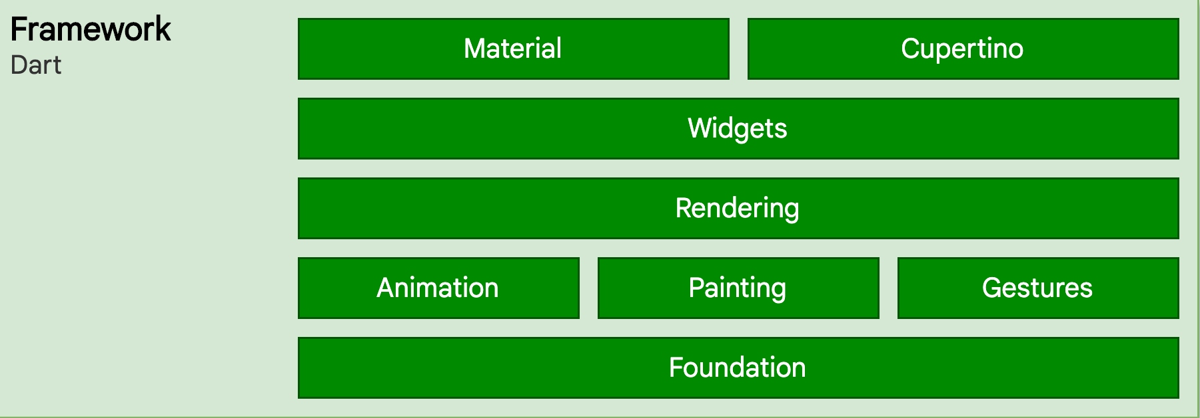
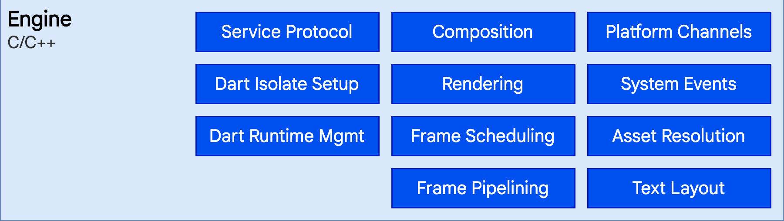
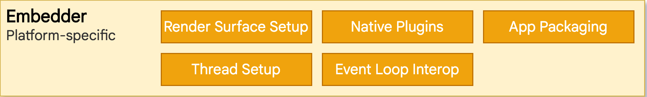
Flutter Architecture

Slide 7
Flutter Architecture
Flutter is designed as an extensible, layered system.
It exists as a series of independent libraries that each depend on the underlying layer.
No layer has privileged access to the layer below, and every part of the framework level is designed to be optional and replaceable.
Flutter applications are packaged in the same way as any other native application.
Embedder (lowest layer)
Engine
Framework (highest layer)

Slide 8
Embedder layer
An entry point is provided by a platform-specific embedder.
It coordinates with the underlying operating system to access services such as
accessibility,
rendering surfaces,
input.
The embedder is written in a platform-specific language like.
Java and C++ for Android
Objective-C/Objective-C++ for iOS and macOS
C++ for Windows and Linux
Flutter code can be embedded into an existing application as a module or as the complete application’s content using the embedder.

Slide 9
Engine layer
The engine layer is written in C/C++.
It takes care of the input, output, network requests.
It handles the difficult translation of rendering whenever a frame needs to be painted.
Flutter uses Skia as its rendering engine.
It is revealed to the Flutter framework through the dart:ui.
It wraps the principal C++ code in Dart classes.

Slide 10
Framework layer
The framework layer is the part where users can interact with Flutter.
The Flutter framework provides a reactive framework that is written in Dart.
It comprises of
Rendering
Widgets
Material and Cupertino
It also has foundational classes and building block services like animation, drawing, and gestures, which are required for writing a Flutter application.

Slide 11
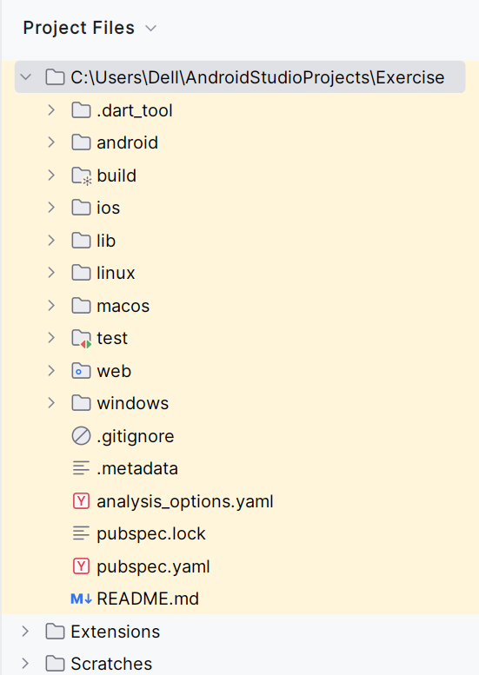
Project Structure
When building large Flutter apps, one of the first things
we should decide is how to structure our project.
The main parts of the project structure are listed below:
pubspec file
assets
lib
android
iOS

Slide 12
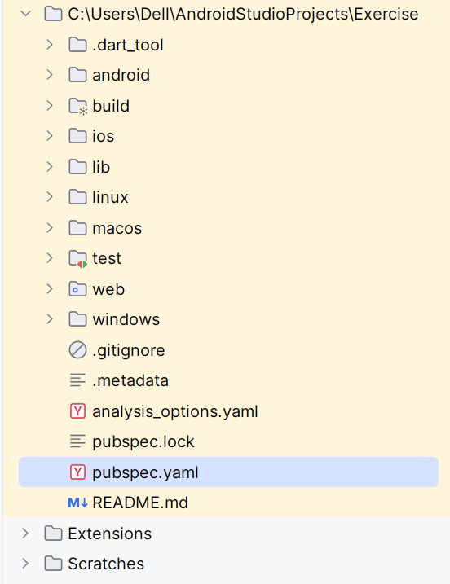
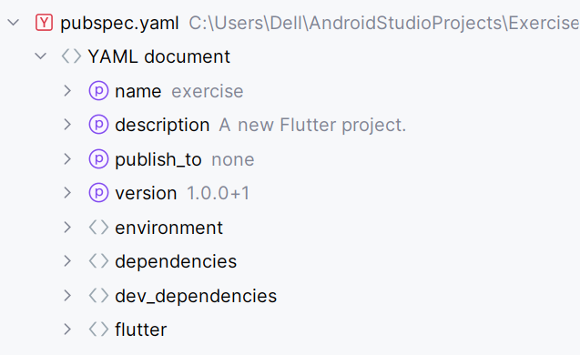
Project Structure
pubspec file: pubspec.yaml file is a project configuration file.
Every Flutter project includes a pubspec.yaml (yet another
markup language) file, often referred to as the pubspec.
A basic pubspec is automatically generated when you create
a new Flutter project.
It is located at the top of the project tree and contains
metadata about the project that the Dart and Flutter tool
needs to know.

Slide 13
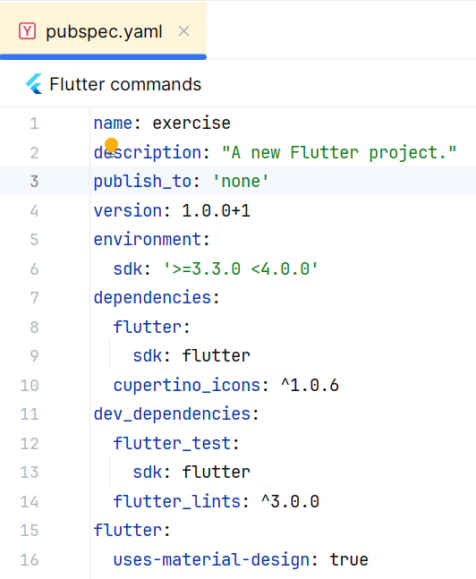
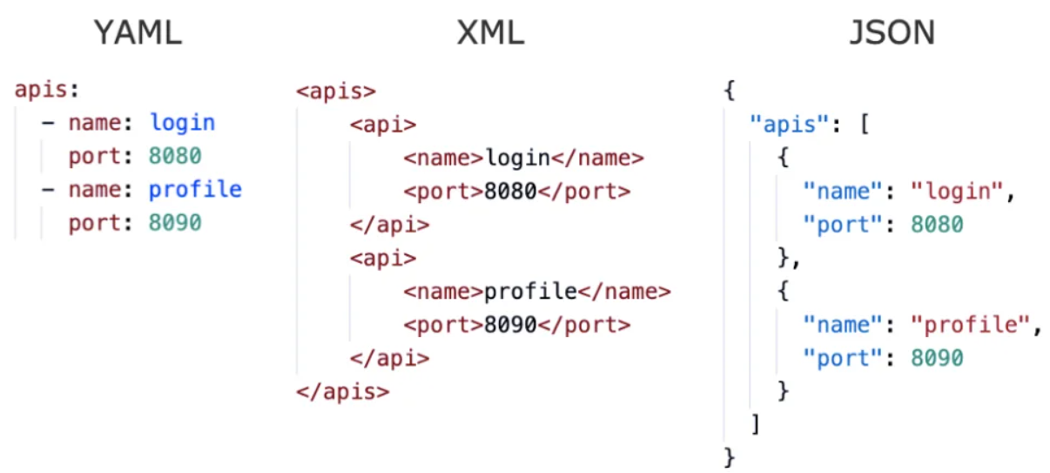
pubspec file
The pubspec is written in YAML, which is human readable, but be aware that white space (tabs & spaces) matters.
The pubspec file specifies dependencies that the project
requires, such as particular packages (and their versions),
fonts, or image files.

Slide 14
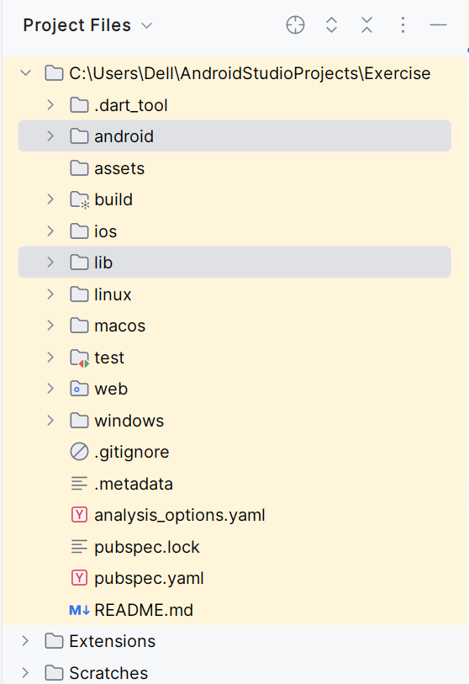
Project Structure
lib
This is the most important folder in the project, used to write most of the dart code.
By default, the lib folder contains the main.dart file, which is the application's entry point.
android
The android folder contains files and folders required for running the application on an Android operating system.
These files and folders are auto generated during the creation of the flutter project.
The android folder’s primary sub-folder are the res folder and Androidmanifest.xml.
The res folder contains non-programmable resources required for the application, like icons, images, and fonts, while the AndroidManifest.xml file contains information required for the application SDK.

Slide 15
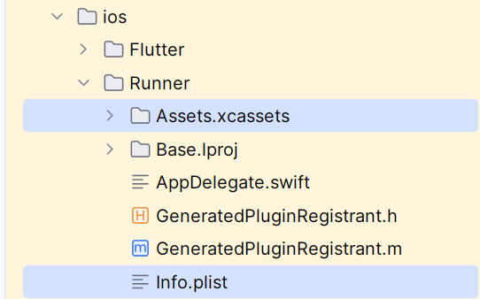
Project Structure
iOS
Like the Android folder, iOS folder contains files required by the application to run the dart code on iOS platforms.
The main files under the iOS folder are Assets.xcassests folder, and info.plist file.
The Assets.xcassests folder is like the res folder in Android.
It contains non-programmable resources required for the application.
The info.plist file is similar to the ‘AndroidManifest.xml’ file.
It stores information required by the SDK of the application.

Slide 16
Structure of flutter app
The structure of a Flutter application is based on the widget tree.
The widget tree is a hierarchical structure of widgets that represents the entire UI of the application.
The root of the widget tree is the MaterialApp widget, which is the main entry point for all Flutter applications.
Structure
1
2
3
4
5
6
MaterialApp
Scaffold
AppBar
Body
Center
Text("Hello, world!")

Slide 17
Flutter widgets
The first thing to note is that in Flutter, everything is a widget.
A widget is simply an instruction that you place within your code and they are the basic building blocks of a Flutter application’s UI.
Widgets indicate how its configuration and status should appear in their display.
When a widget’s state changes, it rebuilds its description.
The framework compares to the previous description to see what changes in the underlying render tree to transition from one state to the next.
A widget can be in the form of a button, an image, an icon, or a layout, and placing the widgets together creates a widget tree.

Slide 18
Introduction to flutter widgets
Flutter widgets are built using a modern framework.
Widgets describe their view on screen how it look, current configuration and state.
Each element on a screen of the Flutter app is a widget.
Widgets are nested with each other to build the app.
It means the root of your app is itself a widget, and all the way down is a widget also.
My App
Material App
My Home Page
Scaffold
App Bar
Safe Area
Bottom Bar
Text
Column
Row

Slide 19
Widget Types
There are a number of other types of widgets in Flutter.
Layout widgets
It is used to arrange other widgets on the screen.
Ex: The Row and Column widgets are layout widgets that can be used to arrange widgets in a horizontal or vertical layout.
Inherited widgets
It is used to share state between multiple widgets.
Ex: The Theme widget is an inherited widget that can be used to share the current theme across an entire app.
Gesture detectors
It is used to detect user input, such as taps, drags, and scrolls.
Ex: The Gesture Detector widget can be used to detect a tap on a widget.
Animated widgets
It is used to create animations.
Ex: The FadeTransition widget can be used to fade in or out a widget over a period of time.

Slide 20
Widget Types
There are two main types of widgets in Flutter.
Stateless widgets
Stateful widgets
Stateless widgets:
It do not have any mutable(Changeable) state.
Their properties cannot change after they have been created.
It is used for simple UI elements, such as text, buttons, and images.
Stateful widgets:
It has mutable(Changeable) state.
Their properties can change over time.
It is typically used for more complex UI elements, such as lists, forms, and dialogs.

Slide 21
Stateless Vs Stateful Widgets
Stateless | Stateful
State is immutable. | State is mutable.
Used for simple UI elements. | Used for complex UI elements.
Widget does not change in the runtime. | It will change its description in runtime.
It is reusable as its state is not changed. | It is less reusable as the state needs to be managed.
Performance is efficient. | Can be inefficient if the state changes frequently.
Ex. Text, Button, Image. | Ex. List, Form, Dialog.

Slide 22
Widget States
State is the behavior of an app at any given moment.
It is a widget’s information when it is first created and how it defines the properties of that widget.
This information might change during the lifetime of the widget.
To build the UI in Flutter there is two types of widgets:
Stateless widgets
Stateful widgets

Slide 23
Stateless Widget
A stateless widget is a widget that describes part of the user interface by building a design that describe the user interface.
Stateless widget are useful when user interface does not depend other than the configuration information.
The build method of a stateless widget is typically only called in three situations:
The first time the widget is inserted in the tree.
Widget's parent changes its configuration.
When an InheritedWidget it depends on changes.

Slide 24
Stateless Widget
Program
1
2
3
4
5
6
7
8
9
10
11
12
class GreenFrog extends StatelessWidget
{
const GreenFrog({ super.key });
@override
Widget build(BuildContext context)
{
return Container(
color: const Color(0xFF2DBD3A),
);
}
}

Slide 25
Stateful Widget
A Stateful Widget has its own mutable state.
It is modified according to the user’s input.
It is looks for two things
The changed state based on its previous state.
An updated view of the user interface.
A Stateful Widget triggers a build() method again for creating its children widgets and the subclass of the state holds the related data.
It is often used in cases where redrawing of a widget is needed.
A Stateful Widget can change when:
There is a User Input included
There are some User Interaction
There are some Dynamic Changes

Slide 26
Stateful Widget
Syntax
1
2
3
4
5
6
7
8
9
10
11
12
13
class MyApp extends StatefulWidget {
const MyApp({Key? key}) : super(key: key);
@override
State<MyApp> createState() => _MyAppState();
}
class _MyAppState extends State<MyApp> {
@override
Widget build(BuildContext context) {
return Container();
}
}
The MyApp is a class that extends Stateful Widget.
A generic method createState() creates a mutable state.
The _MyAppState class extends another state.

Slide 27
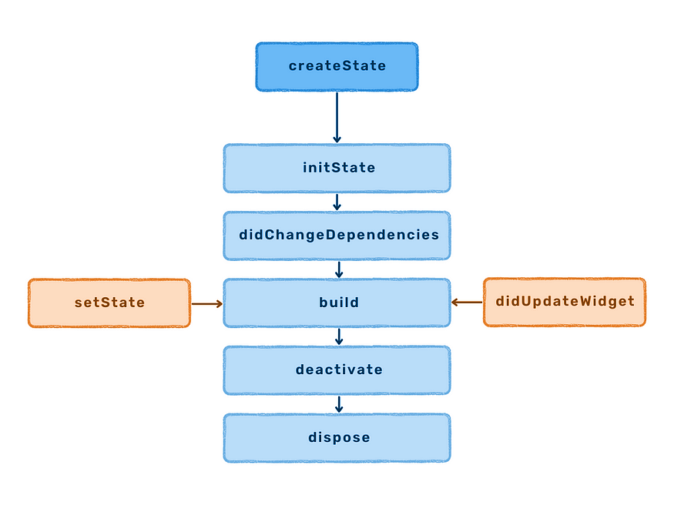
Stateful Widget Life Cycle
The data used by the widget might change.
The data can't be read synchronously when the widget is built.
All state must be established by the time the build method is called.
The lifecycle has the following simplified steps:
createState()
mounted == true
initState()
didChangeDependencies()
build()
didUpdateWidget()
setState()
deactivate()
dispose()
mounted == false

Slide 28
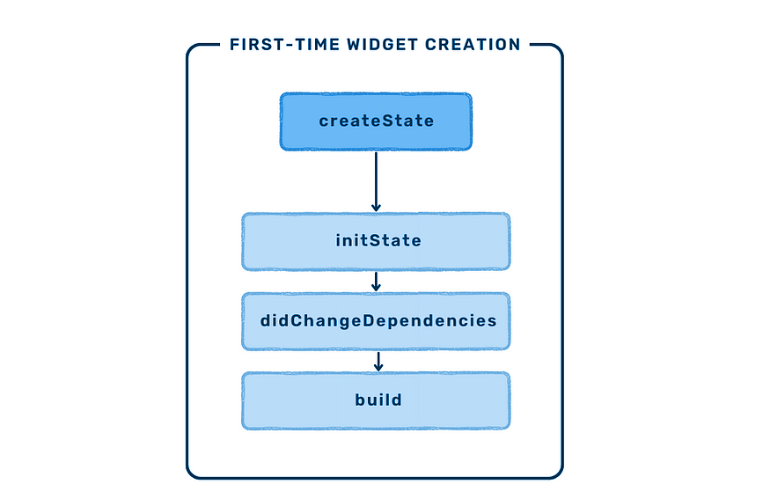
Stateful Widget Life Cycle
createState()
When we create build a StatefulWidget, it immediately calls createState().
This method must exist.
BuildContext is the widget associated with the state.
BuildContext (mounted == true)
It provides information regarding which widget is to be built/re-build.
BuildContext is the widget associated with the state.
Syntax
1
2
3
4
class MyHomePage extends StatefulWidget {
@override
_MyHomePageState createState() => new _MyHomePageState();
}
Syntax
1
2
3
Widget build(BuildContext context) {
return Container();
}

Slide 29
Stateful Widget
initState()
This method is the entry point of a widget.
It initializes all the methods that the build method will depend upon.
This is called only once in a widget’s lifetime
didChangeDependencies()
It is used for loading the dependencies required for execution of a state.
The didChangeDependencies() is called immediately after the initState() is called.
It repaints the widgets that rely on that state for configuration.
Syntax
1
2
3
initState() {
super.init();
}
Syntax
1
2
void didChangeDependencies() {
}

Slide 30
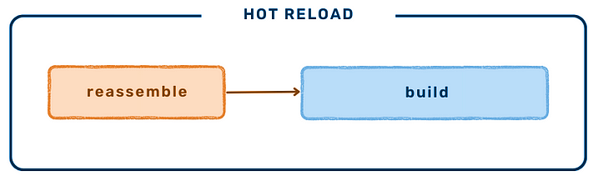
Stateful Widget
build()
This method is called often It is a required, @override and must return a Widget.
didUpdateWidget(Widget oldWidget)
didUpdateWidget() is called if the parent widget changes and has to rebuild this widget.
it's being rebuilt with the same runtimeType, then this method is called.
Flutter is re-using the state, which is long lived.
In this case, required is to initialize some data again, as one would in initState().
Syntax
1
2
3
Widget build(BuildContext context) {
return Container();
}
Syntax
1
2
3
4
5
6
@override
void didUpdateWidget(Widget oldWidget) {
if (oldWidgetsx.importantProperty != widget.importantProperty) {
_init();
}
}

Slide 31
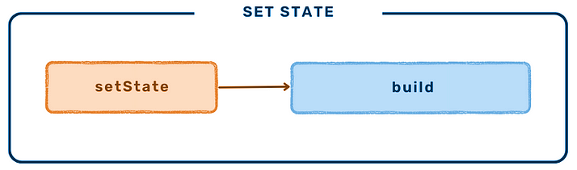
Stateful Widget
setState()
A State object is used to modify the user interface.
It executes the code for a particular callback.
It repaints the widgets that rely on that state for configuration.
deactivate()
This method is called when State is removed from the tree.
It might be reinserted before the current frame change is finished.
This method exists basically because State objects can be moved from one point in a tree to another.
Syntax
1
setState(() {});
Syntax
1
2
3
void deactivate(){
super.deactivate();
}

Slide 32
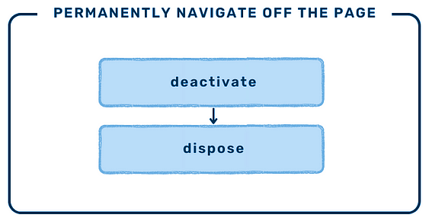
Stateful Widget Life Cycle
dispose()
This method is used for removing an object permanently from the widget tree.
It is used when we need to clear up the memory by invoking super.dispose().
Syntax
1
2
3
void dispose(){
super.dispose();
}

Slide 33
MaterialApp
MaterialApp is a predefined class or widget in a flutter.
It is likely the main or core component of a flutter app.
It provides a wrapper around other Material Widgets.
We can access all the other components and widgets provided by Flutter SDK using MaterialApp class.
There are different properties available to access
action: This property takes in Map<Type, Action<Intent>> as the object. It controls intent keys.
backButtonDispatcher: It decided how to handle the back button.
color: It controls the primary color used in the application.
darkTheme: It provided theme data for the dark theme for the application.
home: This property takes in widget as the object to show on the default route of the app.
initialRoute: This property takes in a string as the object to give the name of the first route in which the navigator is built.
locale: It provides a locale for the MaterialApp.

Slide 34
MaterialApp
title: The title property takes in a string as the object to decide the one-line description of the app for the device.
theme: This property takes in ThemeData class as the object to describe the theme for the MaterialApp.
There are plenty more properties associated with it.

Slide 35
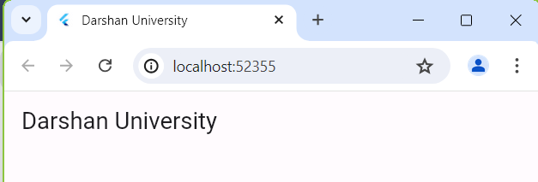
Example
1
2
3
4
5
6
7
8
9
10
11
12
13
14
15
16
17
18
19
20
21
import 'package:flutter/material.dart';
void main() {
runApp(const MaterialScreen());
}
class MaterialScreen extends StatelessWidget {
const MaterialScreen({super.key});
@override
Widget build(BuildContext context) {
return MaterialApp(
title: 'Darshan University',
debugShowCheckedModeBanner: false,
home: Scaffold(
appBar: AppBar(title: const Text('Darshan University')),
),
);
}
}

Slide 36
Scaffold
The Scaffold widget is a layout widget.
It provides a basic structure for the UI of a Flutter application.
It includes an AppBar at the top of the screen, a Body in the center of the screen, and a FloatingActionButton at the bottom of the screen.
It is a flexible widget that can be customized to meet the specific needs of the application.
For example, the AppBar can be configured to include a title, a search bar, or a set of actions.
The Body used to include any widget, such as text, images, lists, or forms.

Slide 37
Properties of Scaffold
Property | Description
appBar | It displays a horizontal bar which mainly placed at the top of the Scaffold.
body | It will display the main or primary content in the Scaffold.
floatingActionButton | FloatingActionButton is an icon button that floats over the content of the screen at a fixed place.
drawer | drawer is a slider menu or a panel which is displayed at the side of the Scaffold.
bottomNavigationBar | bottomNavigationBar is like a menu bar at the bottom of the Scaffold.
backgroundColor | used to set the color of the whole Scaffold widget.
bottomSheet | This property takes in a widget (final) as the object to display it at the bottom of the screen.
endDrawer | It is similar to the Drawer, except the fact it opens in the opposite direction.
resize To Avoid Bottom Insets | This property takes in a Boolean value as the object. If set to true then the floating widgets on the scaffold resize themselves to avoid getting in the way of the on-screen keyboard.

Slide 38
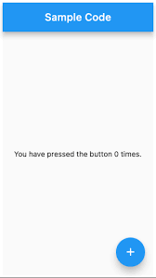
Example
Example
AppBar
1
2
3
4
5
6
7
8
9
10
11
12
13
14
15
16
@override
Widget build(BuildContext context) {
return Scaffold(
appBar: AppBar(title: const Text(‘Darshan University')),
body: const Center(
child: Text(
"Welcome to Darshan University!!!",
style: TextStyle(
color: Colors.black,
fontSize: 40.0,
),
),
),
);
}
Scaffold
Body
Floating Action Button

Slide 39
Safearea
SafeArea is an important and useful widget in Flutter which makes UI dynamic and adaptive to a wide variety of devices.
In different designs and in certain scenarios, App might overlay any pre-occupied constraints like Status bar, notches, navigation bar, etc.
So, in order to make our UI adaptive and error-free, we use SafeArea widget.
SafeArea is basically a padding widget, which adds any necessary padding to your app, based on the device it is running on.
If App’s widgets are overlaying any of the system’s features like notches, status bar, camera or any other such features, then SafeArea would add padding around the app, as required.
Internally SafeArea uses MediaQuery to check the dimensions of the display screen and includes extra padding if needed.

Slide 40
Properties of SafeArea
Property | Description
bottom | This property is of type bool. It is true by default and setting it to false would disable SafeArea from adding padding to the bottom of the screen.
top | This property is also of type bool and setting it to false would avoid padding at top of the screen.
left | This property is of type bool and setting it to false would avoid padding at left side of the screen.
right | This property is of type bool and setting it to false would avoid padding at right side of the screen.
minimum | This property is of type EdgeInsets. You can specify the minimum padding to be added using this property.
maintainBottomViewPadding | This property is of type bool and it specifies whether SafeArea should maintain the viewPadding instead of padding. For instance, if you are using an on-screen keyboard with SafeArea , the the padding can be maintained below the obstruction rather than being consumed.

Slide 41
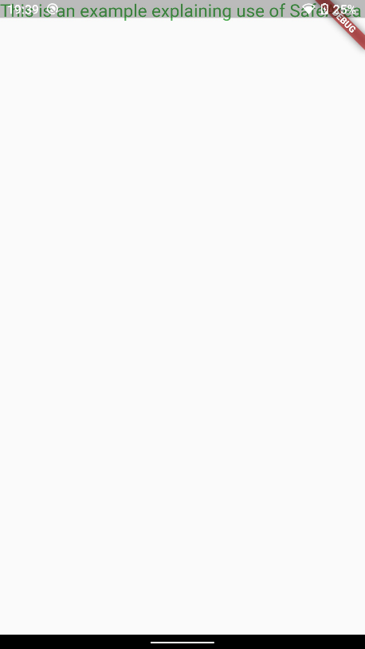
Without SafeArea
Example
1
2
3
4
5
6
7
8
9
10
11
12
13
@override
Widget build(BuildContext context) {
return MaterialApp(
home: Scaffold(
body: Text('This is an example explaining use of SafeArea',
style: TextStyle(color: Colors.green,
fontSize: 20
),
),
),
);
}
Without SafeArea

Slide 42
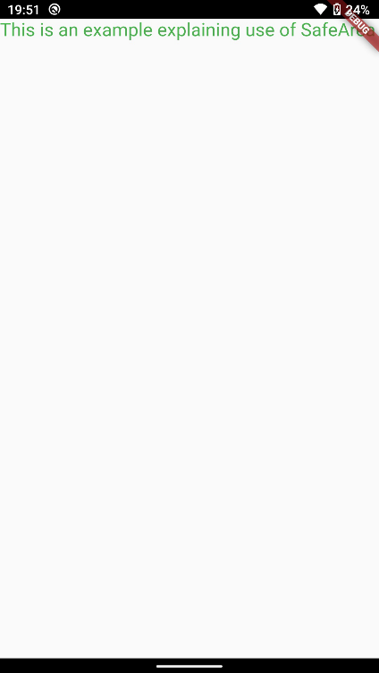
With SafeArea
Example
1
2
3
4
5
6
7
8
9
10
11
12
13
14
15
16
@override
Widget build(BuildContext context) {
return MaterialApp(
home: SafeArea(
top: true
child: Scaffold(
body: Text(
'This is an example explaining use of SafeArea',
style: TextStyle(color: Colors.green, fontSize: 20),
),
),
),
);
}
Using SafeArea

Slide 43
Text Widget
A Text is a widget in Flutter that allows us to display a string of text with a single line in our application.
The text widget can be used by creating the Text widget class and passing the required parameter string.
It will use the app DefaultTextStyle class style.
To change the default textStyle we can use style attribute.
Example
1
Text('This is My String, i am the only required parameter');

Slide 44
Text Styling
Property | Description
textAlign | This property is used to align the text according. Ex: textAlign: TextAlign.center.
textScaleFactor | This property is adjust the font size one is using the textScaleFactor in Text widget or using TextStyle class. Ex: textScaleFactor: 4.0,
color | This property used to set color to the text. Ex: style: TextStyle( color: Colors.blue ),
fontWeight | This property is used to set weight to the text. Ex.: fontWeight: FontWeight.w300,
fontFamily | This property is used to set different font family (.ttf). Ex: fontFamily: "Caveat",

Slide 45
TextField Widget
A TextField or TextBox is an input element which holds the alphanumeric data, such as name, password, address, etc.
It is a GUI control element that enables the user to enter text information using a programmable code.
It can be of a single-line text field or multiple-line text field.
By default, Flutter decorated the TextField with an underline.
We can also add several attributes with TextField, such as label, icon, inline hint text, and error text using an InputDecoration as the decoration.
If we want to remove the decoration properties entirely, it is required to set the decoration to null.

Slide 46
Properties of TextField
Property | Description
decoration | It is used to show the decoration around TextField.
border | It is used to create a default rounded rectangle border around TextField.
labelText | It is used to show the label text on the selection of TextField.
hintText | It is used to show the hint text inside TextField.
Icon | It is used to add icons directly to the TextField.
We can expand a TextField very easily by adding the attributes maxLines (ex. maxLines: 4,).
We can restrict the maximum number of characters inside the text field by adding the maxLength attributes (Ex. maxLength: 10,)
We can convert visible text to password using obscure attribute (Ex.: obscureText: true,).
Flutter allows the user to retrieve the text in mainly two ways:
onChanged method.
the controller method.

Slide 47
TextField
onChanged method
It is the easiest way to retrieve the text field value.
This method store the current value in a simple variable and then use it in the TextField widget.
Controller method
It is the easiest way to retrieve the text field value.
This method store the current value in a simple variable and then use it in the TextField widget.
Example
Example
1
2
3
4
5
6
String value = "";
TextField(
onChanged: (text) {
value = text;
},
)
1
2
3
4
5
6
7
TextEditingController mycontroller = TextEditingController();
TextField(controller: mycontroller,)
controller.addListener(() {
print(controller.text);
});

Slide 48
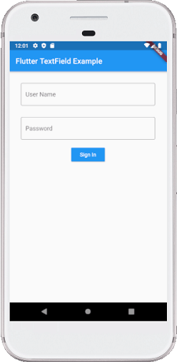
Properties of TextField
Example
Example
1
2
3
4
5
6
7
8
9
10
11
12
13
14
15
16
1718
19
20
@override
Widget build(BuildContext context) {
return Scaffold(
appBar: AppBar(
title: Text('Flutter TextField Example'),),
body: Padding(
padding: EdgeInsets.all(15 child: Column(
children: <Widget>[Padding(
padding: EdgeInsets.all( child: TextField(
decoration: InputDecoration( border: OutlineInputBorder(), labelText: 'User Name',
hintText: 'Enter Your Name’,
),
),
),
21
22
23
24
25
26
27
28
29
30
31
32
33
34
35
36
37
38
39
40
Padding(
padding: EdgeInsets.all(15),
child: TextField(
obscureText: true,
decoration: InputDecoration(
border: OutlineInputBorder(),
labelText: 'Password',
hintText: 'Enter Password',
),
),
),
RaisedButton(textColor: Colors.white,
color: Colors.blue,
child: Text('Sign In'),
onPressed: (){},
)],
))
);
}

Slide 49
Button Widgets
Buttons are the graphical control element that provides a user to trigger an event.
Buttons are the Flutter widgets, which is a part of the material design library.
There are different types of buttons available in flutter:
Flat Button
Raised Button
Floating Button
Icon Button
Inkwell Button
Outline Button

Slide 50
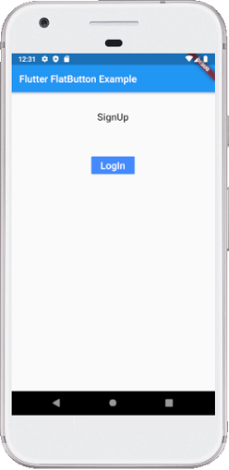
Flat Button
It is a text label button that does not have much decoration and displayed without any elevation.
The flat button has two required properties that are: child and onPressed().
It is mostly used in toolbars, dialogs, or inline with other content.
By default, the flat button has no color, and its text is black.
But, we can use color to the button and text using color and textColor attributes, respectively.
Example
1
2
3
4
5
6
7
8
9
10
@override
Widget build(BuildContext context) {
return FlatButton(
child: Text('LogIn', style: TextStyle(fontSize: 20.0),),
color: Colors.blueAccent,
textColor: Colors.white,
onPressed: () {},
),
}

Slide 51
Raised Button
It is a button, which is based on the material widget and has a rectangular body.
It is similar to a flat button, but it has an elevation that will increases when the button is pressed.
It adds dimension to the UI along Z-axis.
It has several properties like text color, shape, padding, button color, the color of a button when disabled, animation time, elevation, etc.
This button has two callback functions.
onPressed(): It is triggered when the button is pressed.
onLongPress(): It is triggered when the button is long pressed.

Slide 52
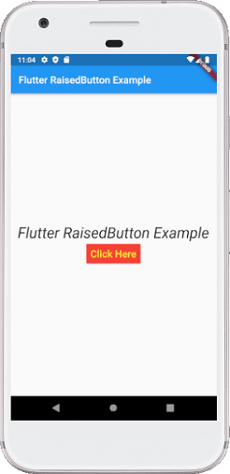
Raised Button
Example
1
2
3
4
5
6
7
8
9
10
11
12
@override
Widget build(BuildContext context) {
return RaisedButton(
child: Text("Click Here", style: TextStyle(fontSize: 20),),
onPressed: _changeText,
color: Colors.red,
textColor: Colors.yellow,
padding: EdgeInsets.all(8.0),
splashColor: Colors.grey,
)
}

Slide 53
Floating Action Button
A FAB button is a circular icon button that triggers the primary action in our application.
We can use this button for adding, refreshing, or sharing the content.
Flutter suggests using at most one FAB button per screen.
There are two types of Floating Action Button:
FloatingActionButton:
It creates a simple circular floating button with a child widget inside it.
It must have a child parameter to display a widget.
FloatingActionButton.extended:
It creates a wide floating button along with an icon and a label inside it.
Instead of a child, it uses labels and icon parameters.

Slide 54
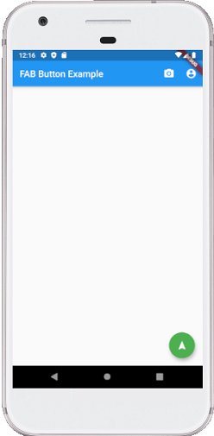
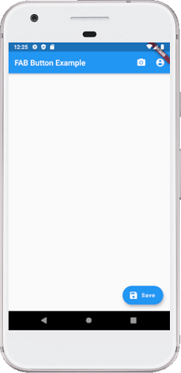
Raised Button
Example
1
2
3
4
5
6
7
8
9
@override
Widget build(BuildContext context) {
return Scaffold(
floatingActionButton: FloatingActionButton(
child: Icon(Icons.navigation),
backgroundColor: Colors.green,
foregroundColor: Colors.white,
onPressed: () => {}, ), ), );
}
Example
1
2
3
4
5
6
7
8
9
10
11
@override
Widget build(BuildContext context) {
return Scaffold(
floatingActionButton: FloatingActionButton.extended(
onPressed: () {},
icon: Icon(Icons.save),
label: Text("Save"),
),
),
);
}

Slide 55
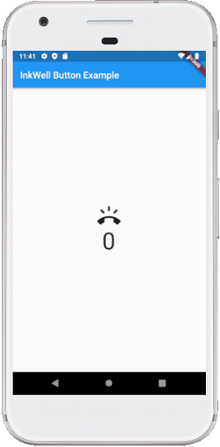
Icon Button
InkWell button is a material design concept, which is used for touch response.
This widget comes under the Material widget where the ink reactions are actually painted.
It creates the app UI interactive by adding gesture feedback.
It is mainly used for adding splash ripple effect.
Example
1
2
3
4
5
6
7
8
9
10
11
12
13
@override
Widget build(BuildContext context) {
return InkWell(
splashColor: Colors.green,
highlightColor: Colors.blue,
child: Icon(Icons.ring_volume, size: 50),
onTap: () {
setState(() {
_volume += 2;
});
}, ),
}

Slide 56
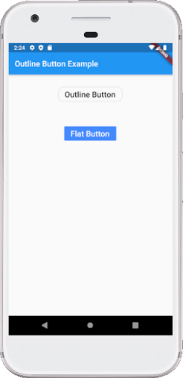
Outline Button
It is similar to the flat button, but it contains a thin grey rounded rectangle border.
Its outline border is defined by the shape attribute.
Example
1
2
3
4
5
6
7
8
9
10
11
12
@override
Widget build(BuildContext context) {
return OutlineButton(
child: Text("Outline Button", style: TextStyle(fontSize: 20.0),),
highlightedBorderColor: Colors.red,
shape: RoundedRectangleBorder(
borderRadius: BorderRadius.circular(15)),
onPressed: () {},
),
}, ),
}

Slide 57
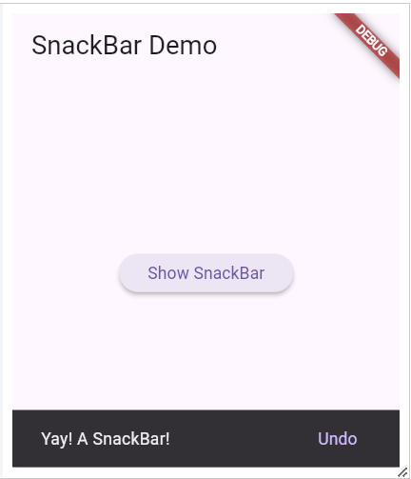
Snack bar
Snack-bar can be useful to briefly inform your users when certain actions take place.
For example, message has been deleted or option to undo the action.
Example
1
2
3
4
5
6
7
8
9
10
11
12
13
@override
Widget build(BuildContext context) {
return MaterialApp(
title: 'SnackBar Demo',
home: Scaffold(
appBar: AppBar(
title: const Text('SnackBar Demo'),
),
body: const SnackBarPage(),
),
);
}
}

Slide 58
Row-Column Widget
These widgets let you align children horizontally and vertically as per the requirement.
To arrange its content in the Row and Column manner so these Row and Column widgets are required when designing UI.
The rows and columns are two different widgets, namely Row and Column.
Both widgets can set several child widgets.
A child widget can also be a row or column widget.
We can align the row's children widget with the help of the following properties.
start: It will place the children from the starting of the main axis.
end: It will place the children at the end of the main axis.
center: It will place the children in the middle of the main axis.
spaceBetween: It will place the free space between the children evenly.
spaceAround: It will place the free space between the children evenly and half of that space before and after the first and last children widget.
spaceEvenly: It will place the free space between the children evenly and before and after the first and last children widget.

Slide 59
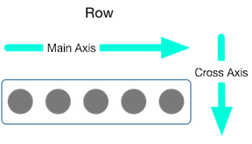
Row Widget
This widget arranges its children in a horizontal direction on the screen.
It will expect child widgets in a horizontal array.
If the child widgets need to fill the available horizontal space, we must wrap the children widgets in an Expanded widget.
A row widget does not scrollable because it displays the widgets within the visible view.
If we want to make a scrollable list of row widgets, we need to use the ListView widget.
To aligns its children based on our choice using the property CrossAxisAlignment and MainAxisAlignment.
The row's cross-axis will run vertically, and the main axis will run horizontally

Slide 60
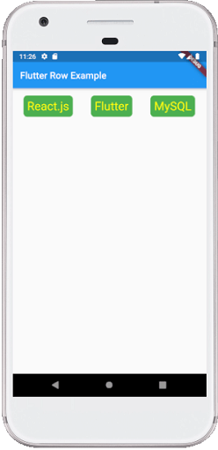
Row Example
Example
Example
1
2
3
4
5
6
7
8
9
10
11
12
13
14
15
16
17
18
19
20
@override
Widget build(BuildContext context){
return Scaffold(
appBar: AppBar(
title: Text("Flutter Row Example"),),
body: Row(
mainAxisAlignment: MainAxisAlignment.spaceEvenly,
children:<Widget>[
Container(
margin: EdgeInsets.all(12.0),
padding: EdgeInsets.all(8.0),
decoration:BoxDecoration(
borderRadius:BorderRadius.circular(8),
color:Colors.green),
child: Text("React.js",style: TextStyle(color:Colors.yellowAccent,fontSize:25),),
),
21
22
23
24
25
26
27
28
29
30
31
32
33
34
35
36
37
38
39
40
41
Container(
margin: EdgeInsets.all(15.0),
padding: EdgeInsets.all(8.0),
decoration:BoxDecoration(
borderRadius:BorderRadius.circular(8),
color:Colors.green),
child: Text("Flutter",style: TextStyle(color:Colors.yellowAccent,fontSize:25),),),
Container(
margin: EdgeInsets.all(12.0),
padding: EdgeInsets.all(8.0),
decoration:BoxDecoration(
borderRadius:BorderRadius.circular(8),
color:Colors.green),
child: Text("MySQL",style: TextStyle(color:Colors.yellowAccent,fontSize:25),),)]),);
}

Slide 61
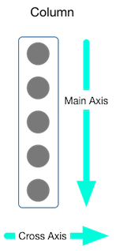
Column Widget
It will expect child widgets in a vertical array.
If the child widgets need to fill the available vertical space, we must wrap the children widgets in an Expanded widget.
A column widget does not scrollable because it displays the widgets within the visible view.
If we want to make a scrollable list of column widgets, we need to use the ListView widget.
To aligns its children based on our choice using the property CrossAxisAlignment and MainAxisAlignment.
The row's cross-axis will run horizontally, and the main axis will run vertically.

Slide 62
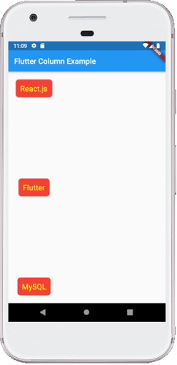
Column Example
Example
Example
1
2
3
4
5
6
7
8
9
10
11
12
13
14
15
16
17
18
19
20
21
@override
Widget build(BuildContext context) { return Scaffold(
appBar: AppBar(
title: Text("Flutter Column Example"),),
body: Column(
mainAxisAlignment: MainAxisAlignment.spaceEvenly,
children:<Widget>[Container(
margin: EdgeInsets.all(12.0),
padding: EdgeInsets.all(8.0),
decoration:BoxDecoration(
borderRadius:BorderRadius.circular(8),
color:Colors.red),
child: Text("React.js",style: TextStyle(color:Colors.yellowAccent,fontSize:25),),
), Container(margin: EdgeInsets.all(15.0),
22
23
24
25
26
27
28
29
30
31
32
33
34
35
36
37
38
39
40
41
padding: EdgeInsets.all(8.0), decoration:BoxDecoration(
borderRadius:BorderRadius.circular(8),
color:Colors.red),
child: Text("Flutter",style: TextStyle(color:Colors.yellowAccent,fontSize:25),), ),
Container(margin: EdgeInsets.all(12.0), padding: EdgeInsets.all(8.0),
decoration:BoxDecoration(
borderRadius:BorderRadius.circular(8),
color:Colors.red),
child: Text("MySQL",style: TextStyle(color:Colors.yellowAccent,fontSize:25),),)
]),
);
}

Slide 63
Properties of Row and Column Widgets
Property | Description
children | This property takes in List<Widget>, that is a list of widgets to display inside the Row or the Column widget.
crossAxisAlignment | The crossAxisAlignment takes in CrossAxisAlignment enum as the object to how the children’s widgets should be places in crossAxisAlignment. For Row it is vertical and for Column it is horizontal.
mainAxisAlignment | This property takes in MainAxisAlignment enum as the object to decide how the children widgets should be place in mainAxisAlignment. For Row it is horizontal and for Column it is vertical.
mainAxisSize | This property decides the size of main-axis by taking in MainAxisSize enum as the object.
textDirection | This property controls the text direction of the Row or Column widget, which can either be from left-to-right (by default) or right-to-left.

Slide 64
Expanded Widget
Expanded widget in flutter take all the available space inside Row-Column.
It is handy when we want a child widget or children widgets to take all the available space along the main-axis.
For Row the main axis is horizontal & vertical for Column.
Expanded widget always be taken as the child of Row, Column, and Flex.
Expanded widget is similar to the Flexible widget in flutter, with its fit property set to FlexFit.tight as default.

Slide 65
Properties of Expanded Widgets
Property | Description
child | This property sets the widget tree to be placed inside the Expanded widget. Expanded widget can be taken as the child of Row, Column, and Flex.
debugTypicalAncestorWidgetClass | This property takes Type as a parameter to set the ParentData for error messages.
Fit | This property controls how the child widget fills the available space. There are two options given by flutter, the first is FlexFit.tight which sets the child to fill the space available to it and the second is FlexFit.loose which allows the child widget to be as large as the available space.
flex | If we decide to distribute the available space unevenly among the children widgets then we use the flex factor to do the same.

Slide 66
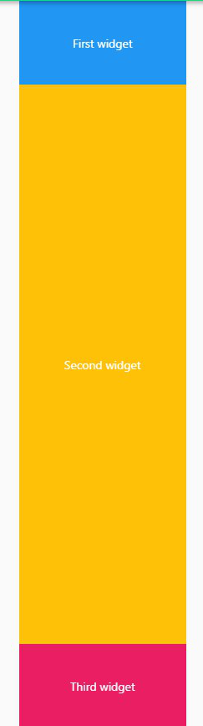
Expanded Widget Example
Example
Example
1
2
3
4
5
6
7
8
9
10
11
12
13
14
15
16
17
18
19
20
@override
Widget build(BuildContext context) {
return Scaffold(
body: Center(
child: Column(
children: <Widget>[
Container(
child: Center(
child: Text(
'First widget’, style:
TextStyle(color: Colors.white,
), ),),
color: Colors.blue,
height: 100,
width: 200,
),
Expanded(
child: Container(
child: Center(
21
22
23
24
25
26
27
28
29
30
31
32
33
34
35
36
37
38
39
40
child: Text(
'Second widget',
style: TextStyle(
color: Colors.white,
),), ),
color: Colors.amber,
width: 200,
),),
Container(
child: Center(
child: Text(
'Third widget',
style: TextStyle(
color: Colors.white,
),),),
color: Colors.orange,
height: 100,
width: 200,
),],)),
),

Slide 67
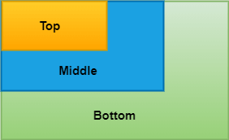
Stack Widgets
The stack is a widget in Flutter that contains a list of widgets and positions them on top of the other.
It allows to overlap multiple widgets into a single screen and renders them from bottom to top.
The first widget is the bottommost item, and the last widget is the topmost item.
The child widget in a stack can be either positioned or non-positioned.
Example
1
2
3
4
5
6
7
8
9
10
11
12
13
Stack(
children: <Widget>[
Container(
color: Colors.green,
),
Container(
color: Colors.blue,
),
Container(
color: Colors.yellow,
)
],
),

Slide 68
Properties of Stack
Property | Description
alignment | It determines how the children widgets are positioned in the stack. It can be top, bottom, center, center-right, etc. Ex: alignment: Alignment.topCenter,
textDirection | It determines the text direction. It can draw the text either ltr (left to right) or rtl (right to the left). Ex: textDirection: TextDirection.rtl,
fit | It will control the size of non-positioned children widgets in the stack. It has three types: loose, expand and passthrough. The loose used to set the child widget small, the expand attribute makes the child widget as large as possible, and the passthrough set the child widget depending on its parent widget. Ex. fit: StackFit.passthrough,
overflow | It controls the children widgets, whether visible or clipped, when it's content overflowing outside the stack. Ex.: overflow: Overflow.clip,
clipBehavior | It determines whether the content will be clipped or not.

Slide 69
Image Widget
When you create an app in Flutter, it includes both code and assets (resources).
An asset is a file, which is bundled and deployed with the app and is accessible at runtime.
The asset can include static data, configuration files, icons, and images.
The Flutter supports many image formats, such as JPEG, WebP, PNG, GIF, animated WebP/GIF, BMP, and WBMP.
Displaying images is the fundamental concept of most of the mobile apps.
Flutter has an Image widget that allows displaying different types of images in the mobile application.

Slide 70
Display local images in Flutter
To display an image in Flutter, do the following steps:
Step 1: First, we need to create a new folder inside the root of the Flutter project and named it assets. We can also give it any other name if you want.
Step 2: Next, inside this folder, add one image manually.
Step 3: Update the pubspec.yaml file. Suppose the image name is tablet.png, then pubspec.yaml file is.
If the assets folder contains more than one image, we can include it by specifying the directory name with the slash (/) character at the end.
Example
1
2
3
assets:
- assets/tablet.png
- assets/background.png
Example
1
2
3
flutter:
assets:
- assets/

Slide 71
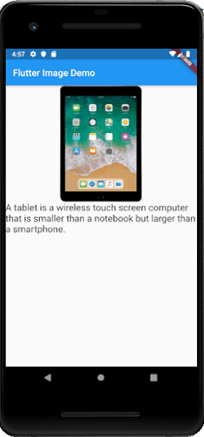
Image Widget
Example
1
2
3
4
5
6
7
8
9
10
11
12
13
14
15
16
17
18
@override
Widget build(BuildContext context) {
return Scaffold(
body: Center(
child: Column(
children: <Widget>[
Image.asset('assets/tablet.png'),
Text(
'A tablet is a wireless touch screen computer that is smaller than a notebook but larger
than a smartphone.',
style: TextStyle(fontSize: 20.0),
)
],
),
),
);
}

Slide 72
Display images from the internet
Displaying images from the internet or network is very simple.
Flutter provides a built-in method Image.network to work with images from a URL.
The Image.network method also allows you to use some optional properties, such as height, width, color, fit, and many more.
We can use the following syntax to display an image from the internet.
Example
1
2
3
Image.network(
'https://picsum.photos/250?image=9',
)

Slide 73
Container Widget
The container in is a parent widget that can contain single child widget and manage them efficiently through width, height, padding, background color, etc.
It is a widget that combines common painting, positioning, and sizing of the child widgets.
It is similar to a box for storing contents.
It allows many attributes to the user for decorating its child widgets.
A container widget is same as <div> tag in html.
If this widget does not contain any child widget, it will fill the whole area on the screen automatically.
Otherwise, it will wrap the child widget according to the specified height & width.

Slide 74
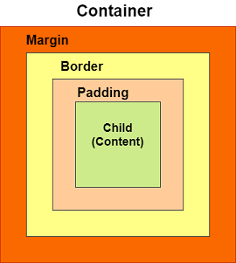
Container Widget
A basic container has a margin, border, and padding properties surrounding its child widget, as shown in the image.
If we have a widget that needs some background styling may be a color, shape, or size constraints, we may try to wrap it in a container widget.
This widget helps us to compose, decorate, and position its child widgets.
Property | Description
child | This property is used to store the child widget of the container.
color | This property is used to set the background color.
height and width | This property is used to set the container's height and width according to our needs. By default, it takes the space based on its child widget.
margin | This property is used to surround the empty space around the container.
padding | This property is used to set the distance between the border of the container and its child widget.
decoration | This property allows the developer to add decoration on the widget. It decorates or paint the widget behind the child.

Slide 75
Card Widget
Card is a build-in widget in flutter which derives its design from Google’s Material Design Library.
It is a rounded corner shape and has a shadow.
We just need to call the card constructor and then pass a widget as child property for displaying the content.
Property | Description
borderOnForeground | It is used to paint the border in front of a child. By default, it is true. If it is false, it painted the border behind the child.
Color | This property is used to set the background color.
Elevation | It controls the shadow size below the card. The bigger elevation value makes the bigger shadow distance.
margin | This property is used to surround the empty space around the container.
shape | It is used to specify the shape of the card.
shadowColor | It is used to paint the shadow of a card.

Slide 76
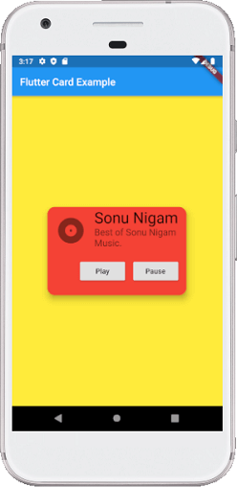
Card Widget Example
Example
Example
1
2
3
4
5
6
7
8
9
10
11
12
13
14
15
16
17
18
19
20
21
22
@override
Widget build(BuildContext context){
return Center(
child: Container(
width: 300,
height: 200,
padding: new EdgeInsets.all(10.0),
child: Card(shape: RoundedRectangleBorder(
borderRadius: BorderRadius.circular(15.0), ),
color: Colors.red,
elevation: 10,
child: Column(mainAxisSize: MainAxisSize.min,
children: <Widget>[
const ListTile(leading: Icon(Icons.album, size: 60),
title: Text('Sonu Nigam',
style: TextStyle(fontSize: 30.0) ),
23
24
25
26
27
28
29
30
31
32
33
34
35
36
37
38
39
40
41
42
43
44
subtitle: Text(
'Best of Sonu Nigam Music.', style: TextStyle(fontSize: 18.0)
),),
ButtonBar(children: <Widget> RaisedButton(child: const Text('Play'),
onPressed: () {/* ... */},
),
RaisedButton(
child: const Text('Pause'),
onPressed: () {/* ... */},
),],
),
],
),
),
)
);
}

Slide 77
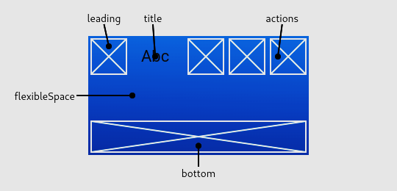
App Bar
An app bar consists of a toolbar and other widgets.
The AppBar displays the toolbar widgets, leading, title, and actions, above the bottom (if any).
The bottom is usually used for a TabBar.
If a flexibleSpace widget is specified then it is stacked behind the toolbar and the bottom widget.

Slide 78
App Bar Example
Example
Example
1
2
3
4
5
6
7
8
9
10
11
12
13
14
15
16
17
18
19
20
21
22
import 'package:flutter/material.dart’;
void main() => runApp(const AppBarApp());
class AppBarApp extends StatelessWidget {
const AppBarApp({super.key});
@override
Widget build(BuildContext context) {
return const MaterialApp(
home: AppBarExample(),
);
}
}
class AppBarExample extends StatelessWidget{
const AppBarExample({super.key});
@override
Widget build(BuildContext context) {
return Scaffold(
appBar: AppBar(
title: const Text('AppBar Demo'),
actions: <Widget>[
IconButton(
icon: const Icon(Icons.add_alert),
23
24
25
26
27
28
29
30
31
32
33
34
35
36
37
38
39
40
41
tooltip: 'Show Snackbar',
onPressed: () {ScaffoldMessenger.of(context).showSnackBar(
const SnackBar(content: Text('This is a snackbar')));
},
),
IconButton(icon: const Icon(Icons.navigate_next),
tooltip: 'Go to the next page',
onPressed: () {
Navigator.push(context, MaterialPageRoute<void>(
builder: (BuildContext context) {
return Scaffold( appBar: AppBar(
title: const Text('Next page'),),

Slide 79
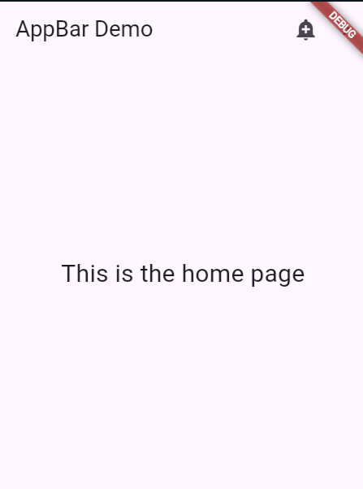
App Bar Example
Example
42
43
44
45
46
47
48
49
50
51
52
53
54
55
56
57
58
59
60
61
62
body: const Center(
child: Text(
'This is the next page’, style: TextStyle(fontSize: 24),
),
),
);
},
));
},
),
],
),
body: const Center(
child: Text(
'This is the home page',
style: TextStyle(fontSize: 24),
),
),
);
}
}

Slide 80
Popup
The Popup displays a menu when pressed and calls onSelected when the menu is dismissed because an item was selected.
The value passed to onSelected is the value of the selected menu item.
In almost every Application there is a Pop Up Menu button to perform a task.

Slide 81
Popup Example
Example
Example
1
2
3
4
5
6
7
8
9
10
11
12
13
14
15
16
17
18
19
20
21
22
import 'package:flutter/material.dart';
// This is the type used by the popup menu
enum SampleItem { itemOne, itemTwo, itemThree }
void main() => runApp(const PopupMenuApp());
class PopupMenuApp extends StatelessWidget {
const PopupMenuApp({super.key});
@override
Widget build(BuildContext context) {
return const MaterialApp(
home: PopupMenuExample(),
);}
}
class PopupMenuExample extends StatefulWidget {
const PopupMenuExample({super.key});
@override
State<PopupMenuExample> createState() => _PopupMenuExampleState();
}
23
24
25
26
27
28
29
30
31
32
33
34
35
36
37
38
39
40
41
42
class _PopupMenuExampleState extends State<PopupMenuExample> {
SampleItem? selectedItem;
@override
Widget build(BuildContext context) {
return Scaffold(
appBar: AppBar(title: const Text('PopupMenuButton')),
body: Center(
child: PopupMenuButton<SampleItem>(
initialValue: selectedItem,
onSelected: (SampleItem item) {
setState(() {
selectedItem = item;
});
},
itemBuilder: (BuildContext context) => <PopupMenuEntry<SampleItem>>[
const PopupMenuItem<SampleItem>(
value: SampleItem.itemOne,

Slide 82
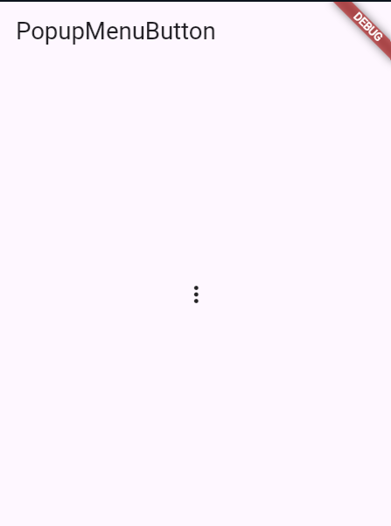
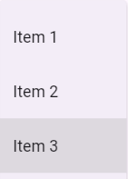
Popup Example
Example
45
46
47
48
49
50
51
52
53
54
55
56
57
58
59
60
child: Text('Item 1'),
),
const PopupMenuItem<SampleItem>(
value: SampleItem.itemTwo,
child: Text('Item 2'),
),
const PopupMenuItem<SampleItem>(
value: SampleItem.itemThree,
child: Text('Item 3'),
),
],
),
),
);
}
}

Slide 83
Drawer
A drawer is a panel that slides in horizontally from the edge of a Scaffold to show navigation links in an application.
Drawers are used with the Scaffold.drawer property.
The child of the drawer is usually a ListView whose first child is a DrawerHeader that displays status information about the current user.
The remaining drawer children are often build using ListTiles.
An appropriate IconButton is used to show the Drawer by the AppBar automatically in the Scaffold.
The Scaffold also handles the edge-swipe gesture to show the drawer.

Slide 84
Drawer Example
Example
Example
1
2
3
4
5
6
7
8
9
10
11
12
13
14
15
16
17
18
19
20
21
22
import 'package:flutter/material.dart’;
void main() => runApp(const DrawerApp());
class DrawerApp extends StatelessWidget {
const DrawerApp({super.key});
@override
Widget build(BuildContext context) {
return MaterialApp(
theme: ThemeData(useMaterial3: true),
home: const DrawerExample(),
);
}
}
class DrawerExample extends StatefulWidget {
const DrawerExample({super.key});
@override
State<DrawerExample> createState() => _DrawerExampleState();
}
class _DrawerExampleState extends State<DrawerExample> {
String selectedPage = ‘ ‘;
23
24
25
26
27
28
29
30
31
32
33
34
35
36
37
38
39
40
41
42
43
44
@override
Widget build(BuildContext context) {
return Scaffold(
appBar: AppBar(
title: const Text('Drawer Example'),
),
drawer: Drawer(
child: ListView(
padding: EdgeInsets.zero,
children: <Widget>[
const DrawerHeader(
decoration: BoxDecoration(
color: Colors.blue,
),
child: Text(
'Drawer Header',
style: TextStyle(
color: Colors.white,
fontSize: 24,
),
),
),

Slide 85
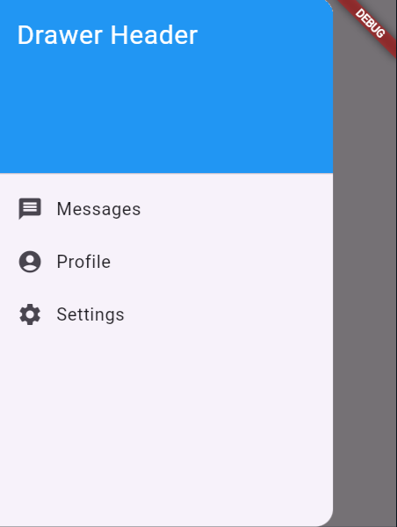
Drawer Example
Example
Example
45
46
47
48
49
50
51
52
53
54
55
56
57
58
59
60
61
62
63
64
65
66
ListTile(
leading: const Icon(Icons.message),
title: const Text('Messages’),
onTap: () {
setState(() {
selectedPage = 'Messages’;
});
},),
ListTile(
leading: const Icon(Icons.account_circle),
title: const Text('Profile'),
onTap: () {
setState(() {
selectedPage = 'Profile';
});
},
),
ListTile(leading: const Icon(Icons.settings),
title: const Text('Settings'),
onTap: () {
67
68
69
707172737475
76
77
78
79
80
setState(() {
selectedPage = 'Settings';
});
},
),
],
),
),
body: Center( child: Text('Page: $selectedPage'),
),
);
}
}

Slide 86

Mobile Application Development using Flutter (MADF)
DU # 2104CS501
Dr. Sharon V Mohtra
Department of Computer Applications
sharon.mohtra@darshan.ac.in

